Slide 1

Childbearing, Psychiatric Illness and Maternal Infant Health
An Update
for Clinicians
P. Lynn Ouellette MD

Slide 2
Goals of this Presentation
Why the focus on “perinatal” “maternal” psychiatric illness?
What are the implications for WOMEN?
What the implications for CHILDREN?
Why is this a larger public health issue?
What are the latest findings for treatment during pregnancy?
What are the recent findings regarding treatment of postpartum illness?

Slide 3
Questions For The Attendees
How many of you practice perinatal psychiatry or medicine?

Slide 4
How many of you treat women of child bearing age or family members of women of childbearing age ?

Slide 5
Why The Focus On “Maternal” Psychiatric Illness?
The association between childbirth and psychiatric illness has been recognized since the 1600’s
Depression is the second leading cause of disability among women of child bearing age (consider suffering and functional impairment)
In the U.S. depression is the leading cause of non-obstetric hospitalizations for women
The perinatal period, from conception to 1 year after birth, is a critical time of phenomenal development and change for both the mother and the infant; this can be profoundly impacted by psychiatric illness
This has huge implications for prevention, early intervention and treatment.

Slide 6
Public Health Issue
Women of childbearing age: 15-49
    20 % of the population
Percentage of unplanned pregnancies: 50%
(80 % of teen pregnancies are unplanned)
Over four million live births in the US each year.
  Considering just POSTPARTUM depression alone
  About 15% will have postpartum depression
  Since about 10% are teen mothers, of whom 30-50% will experience PPD
  660,000 Babies at risk for being affected by PPD alone each year
The group that experiences antenatal depression and PPD overlaps but is not the same; exposure to maternal anxiety disorders imposes risks as well and is an overlapping, but separate group

Slide 7
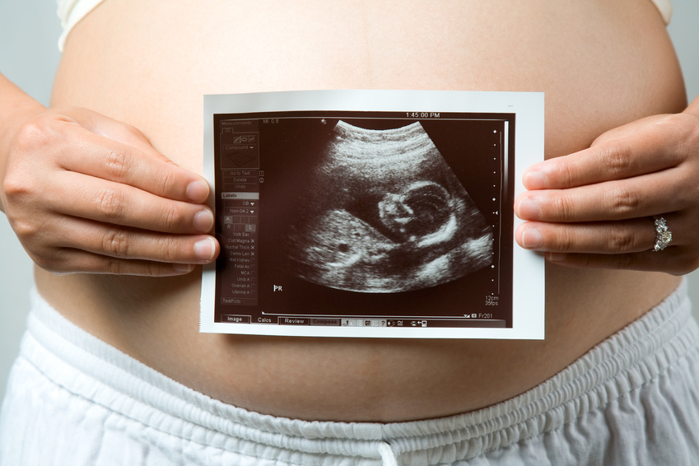
Maternal Psychiatric Illness and Fetal Health

Slide 8
Antenatal Depression and Anxiety
Between 10-20% of women will experience significant depression during pregnancy
( higher in teens)
Routine screening for depression during pregnancy is uncommon
Typically depression during pregnancy is untreated or incompletely treated
Anxiety disorders (OCD, GAD) generally worsen during pregnancy, but are less well studied and even less frequently diagnosed and treated.

Slide 9
Maternal Risks of Untreated Depression During Pregnancy
Obstetrical risks (higher rates of miscarriage, preterm labor, placental abruption, preeclampsia
Lack of adequate prenatal care
Higher use of tobacco, alcohol and drugs
subsequent postpartum depression
SUBSEQUENT RECURRENT EPISODES OF DEPRESSION
SUICIDE

Slide 10
Effects of Maternal Anxiety, Stress, and Depression
Solid evidence indicates exposure to antenatal
stress or anxiety predisposes infants/children to:
LBW, PTB, IUGR (being born small or early)
ADHD
developmental/cognitive/language delays
anxiety/depression
behavioral/emotional problems

Slide 11
Effects of Maternal Anxiety, Stress, and Depression
Studies have been done using a wide range of measures:
Fetal stress assessments
Developmental scales
Cognitive scales
Behavioral scales
EEGs—right frontal asymmetry
Notes:
Rt frontal asymmetry—same pattern as L frontal hypoactivity seen with depressed adults; toddlers with this pattern show more hostility, more negative emotion;

Slide 12
Effects of Maternal Anxiety, Stress, and Depression
Altered lateralization/mixed handedness
Brain scanning– changes in brain morphology (prefrontal, lateral temporal, premotor cortex, medial temporal lobe, cerebellum– areas responsible for cognition, social and emotional processing, auditory language processing)
Some studies suggest that anxiety may play a more powerful role than depression in the antenatal period while other studies dispute this

Slide 13
What is the mechanism?
Not completely clear……
Stress, anxiety and depression cause increased maternal catecholamines, glucocortiocoids, proinflammatory cytotokines
Cortisol passes through the placenta and appears to play a role in programming the fetal HPA axis and to be subject to genetic and epigenetic modification—”Fetal Programming”
Catecholamines play a role in vasoconstriction and diminishing blood flow to the fetus
Notes:
Normally the placental barrier enzyme 11-beta-Hydroxysteroid dehydrogenase inhibits the passage of cortisol to the infant. But high maternal stress inhibits the production of this enzyme by decreasing the expression of mRNA allowing more cortisol to pass through. History of maternal trauma, but not depression associated with a pro inflammatory response

Slide 14
ALSPAC* Study
Increased conduct, emotional, ADHD associated with prenatal maternal anxiety
Conduct problems and ADHD were higher in boys; emotional problems higher in girls
Problems were persistent at age 13 (followed to this age so far)
Independent of postnatal maternal mood
Salivary cortisol levels demonstrated dysfunction in the normal diurnal variation
*Avon Longitudinal Study Of Parents And Children
Notes:
Greater incidence of asthma with exposure to prenatal anxiety

Slide 15
The Effects Are Long Lasting
The effects of fetal exposure to maternal anxiety and depression last into adulthood:
Increased risk of psychiatric illness
Diminished vocational capacity
Increase risk of medical illness– HTN, Obesity, Type II Diabetes, cardiovascular disease
  Elevated exposure to glucorticoids in utero can permanently alter the expression of hepatic genes that regulate glucose and fat metabolism
Exposure to antenatal maternal stress, anxiety and depression is often the earliest adverse life experience
Notes:
Probably different critical time periods– e.g. schizophrenia risk associated with severe stress in the first trimester

Slide 16
Challenges
Hard to study—complex interplay of neurochemical, hormonal, genetic, epigenetic, psychosocial…. Factors
Translating to treatment decisions
  Weighing the risk and the benefits of pharmacologic treatment is not always simple
  Both SSRIs and antenatal depression
    lead to altered less favorable stress responses in the fetus—but they have a different profile of response
    are associated with increased spontaneous abortion
    are associated with preterm delivery
Notes:
Heightened heart rates in reaction to stimulus; with MDD

Slide 17
Antenatal Screening
Routine antenatal screening for maternal depression and anxiety with appropriate intervention would be an extremely effective early intervention
Notes:
Depression during pregnancy is the most robust predictor of postpartum depression

Slide 18
Postpartum Intervention and Reversibility?
Outcomes associated with exposure to maternal anxiety and depression can be strongly influenced by the postnatal environment.
Evidence shows that the detrimental effects of exposure to antenatal anxiety and depression can be mitigated by secure maternal attachment and strong mothering
Studies suggest that high risk infants are most susceptible to the impact of these post natal influences
Notes:
Effects of prenatal anxiety can be mitigated by partner support

Slide 20
BUT……… maternal adversity such as prenatal depression and anxiety predisposes to postpartum psychiatric illness which can disrupt maternal infant attachment and interfere with positive forms of maternal care

Slide 21

Postpartum Psychiatric Illness and Infant Health

Slide 22
Spectrum of Postpartum Mood Disorders
Postpartum Psychosis(0.1-0.2%)
Postpartum Depression(10-15%)
Postpartum
Symptom
Severity
Postpartum Blues (50-85%)
None

Slide 23
PPD vs. Postpartum Psychosis
PPD usually has a gradual onset within the first month; peak occurrence at 3 months
PP begins earlier and rapidly usually within 2 weeks, often within 48-72 hours
PPD presents with characteristic symptoms of MDD often with a significant anxiety component; women often find it difficult to sleep when the baby is sleeping and express concerns about their capacity to care for their babies
PP often is labile with agitation, restlessness, disorganization, confusion, can appear “organic” and is accompanied by delusion and/or auditory hallucinations

Slide 24
PPD vs. Postpartum Psychosis
PPD may be accompanied by intrusive egodystonic thoughts or images of harm to the baby that are frightening to the woman
  Do not increase the risk of harm
  Often accompanied by protective behavior
  Does not necessitate separation of mother and baby
PP may have thoughts of harming the baby or herself driven by delusions or auditory hallucinations
  Risk of harm is serious
  Risk of infanticide is 4%
  Risk of suicide is 5%
  Emergency treatment and psychiatric admission is a necessity

Slide 25
PDD and Postpartum Psychosis
Are these illnesses distinct from mood disorders that occur at times other than during the perinatal period?
Not in the DSM–postpartum onset specifier
  Control for other risk factors—increase risk for PPD, increase sensitivity to hormonal manipulation
  ¼ women with Bipolar disorder will have an episode of PP
  50% of women with prior PP will have another episode with subsequent pregnancy
  Markedly increased risk of being hospitalized within first month postpartum
  Episodes of postpartum psychosis represent a more familial form of bipolar disorder
  Emerging subgroup of women who may be susceptible to affective psychosis only in the postpartum period

Slide 26
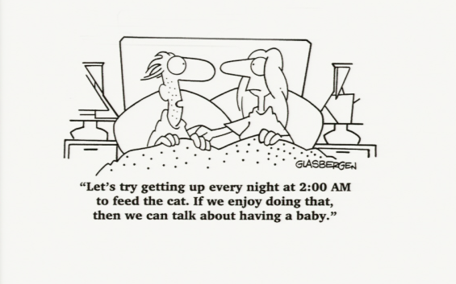
What Is The Trigger For Postpartum Depression?

Slide 27
No Simple Answers
What exactly is the trigger– stressful life event, psychological issues with transition into motherhood, change in gonadal steroids, stress hormones, neuroendocrine changes , genetic factors?
Perinatal mood disorders are probably a heterogeneous group
Cannot forget that there is a social cultural context– poverty, social isolation, intimate partner violence, lack of extended family support

Slide 28
Maternal Impact of Untreated PPD
Stressful impact on relationship with partner
Kindling phenomenon---development of a chronic low grade depression with more susceptibility to repeated episodes of MDD
Severe postpartum psychiatric disorder is associated with a high rate of death from natural and unnatural causes, particularly suicide
Suicide risk in the first postnatal year is increased 70-fold

Slide 29
Impact of Untreated Postpartum Maternal Depression on the Infant
  Poor weight gain
  Sleep problems
  More likely to have colic
  Less breastfeeding-depressed mothers more likely to discontinue breastfeeding
  Higher incidence of asthma and other illness
  Impaired maternal health and safety practices
  Increased risk of child abuse and neglect

Slide 30
Impact of Untreated Postpartum Maternal Depression on the Infant
Disruption in the attuned infant-caregiver interactions which promote healthy brain neurological “wiring” predisposing to:
  Future , hyperactivity, conduct disorders and school behavior problems
  Delays in language and social development
  Increased risk of depression and anxiety disorders

Slide 31
Impact of Untreated Postpartum Maternal Depression on the Child
  More emotional instability, suicidal behavior and conduct problems
  Future social, educational and vocational difficulties
  Future psychiatric and medical illness
  Maternal depression is an “Adverse childhood experience” ACE, and often it is not the only adversity

Slide 32
Maternal Depression Effects The Older Siblings Too
Most studies are done on maternal, not specifically postpartum depression
One study found that 1/3 of children ages 7-17 with moderate to severely depressed mothers had a psychiatric diagnosis
Because we more readily focus on the mother and the newborn, we forget that the other children in the family are at risk too
Successful treatment of the maternal symptoms often, but not always, causes the child’s symptom’s to remit

Slide 33
Summary: Impact of PPD
Diminished maternal ability to function in many roles particularly the core parenting role with long lasting adverse effects on child’s health, cognitive and emotional development and ongoing risk to mother’s emotional, physical, and social wellbeing.
Treatment for mother is prevention or early intervention for child

Slide 34
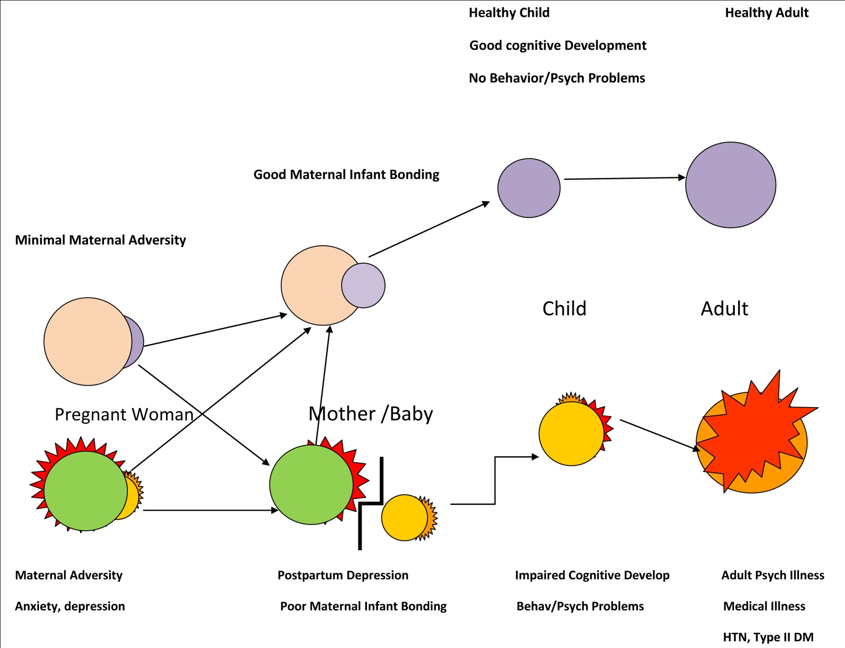
Why the focus on “maternal” psychiatric illness?

Slide 35
Perinatal Maternal Psychiatric Illness: Transmission of risk from mother to child
Heritability
Dysfunctional neuroregulatory mechanisms
Exposure to maternal negative or maladaptive cognitions, behaviors and affect
Exposure to a stressful environment
The developmental implications of postpartum depression and integration with clinical intervention, Goodman, S and Dimidjian, S, Marce’ Society Meeting

Slide 36


Slide 37
Why the focus on “maternal” psychiatric illness?

Slide 38
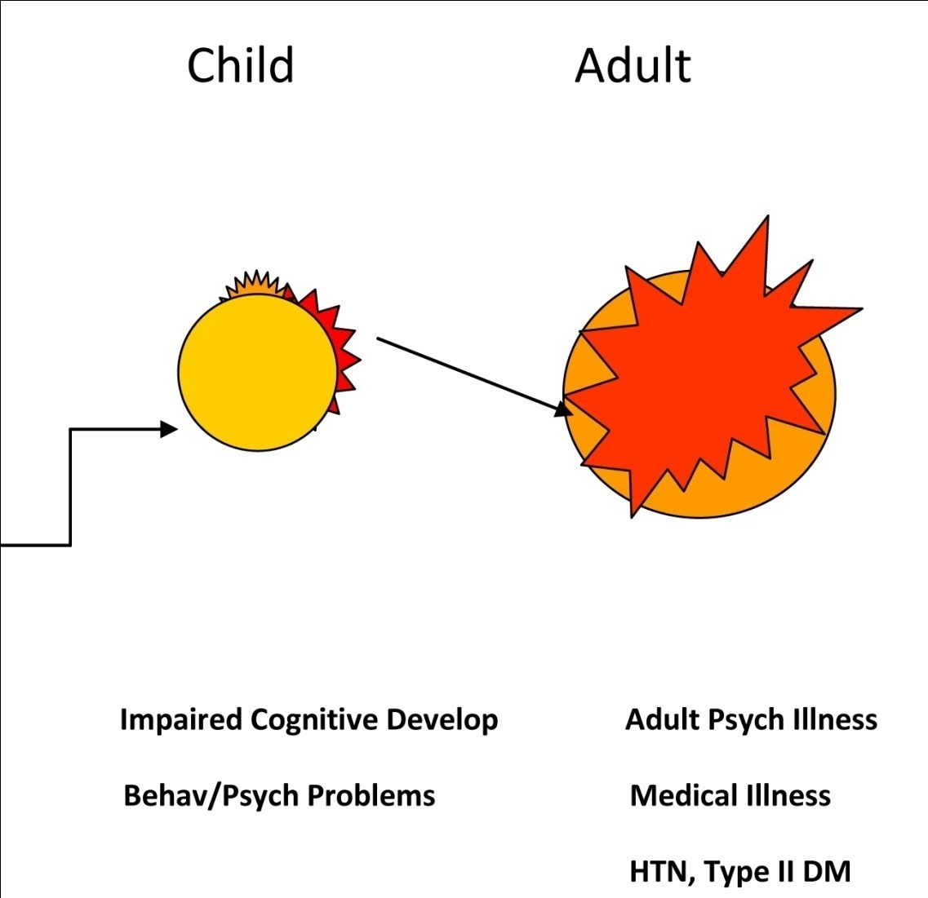
WHY NOT SHIFT THE FOCUS OF OUR HEALTHCARE ATTENTION FROM HERE…………….

Slide 39
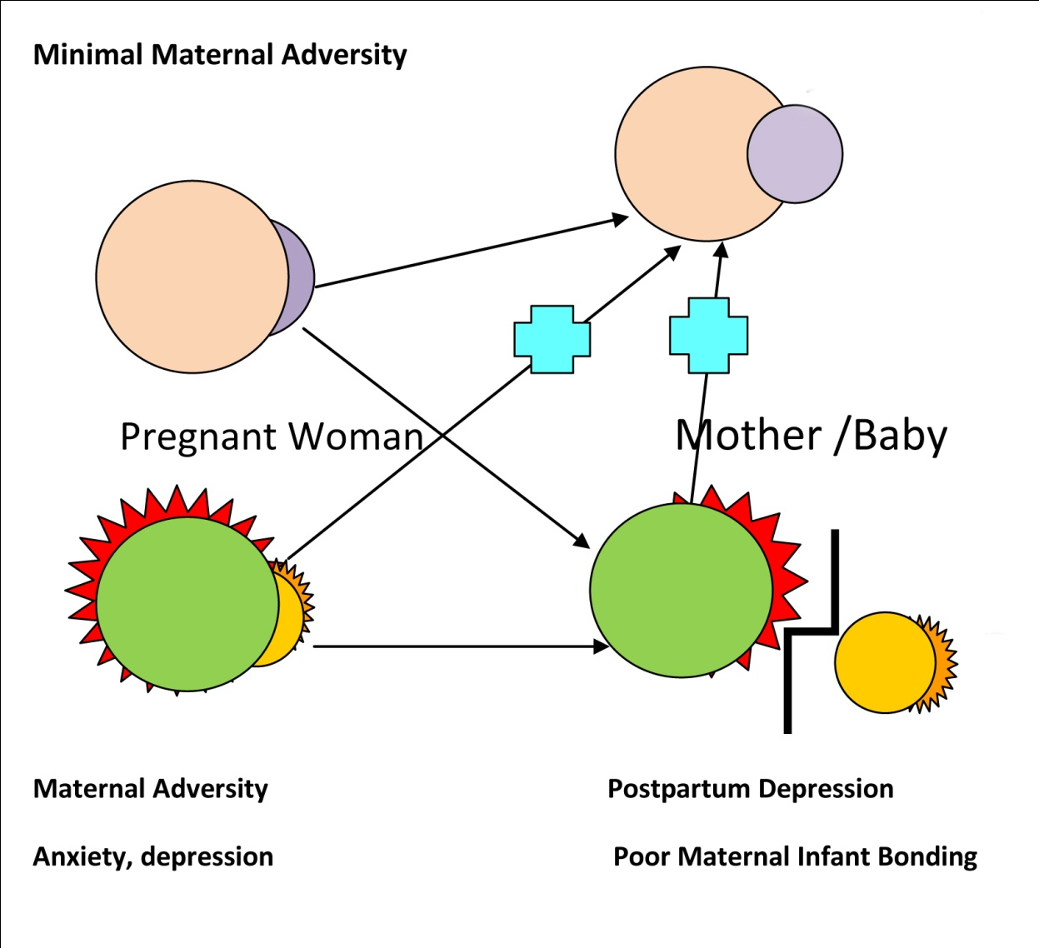

TO EARLY INTERVENTION….

Slide 40
How can we do that?
Diminish patient barriers to treatment—primarily through education
  about perinatal illness
  and its treatment
Decrease stigma through public education
Provider education
  About screening—not overly burdensome to screen, much more effective to use formal, validated screening tools
  About treatment—treatment is extremely well studied and the relative safety well documented
  About the impact of not treating
Financial reform to reimburse for mental illness screening and treatment—early intervention would actually SAVE healthcare dollars
Increase early identification and effective treatment

Slide 41
Obstacles
  Physicians have too little time already
  an evolving field with new findings emerging all the time
  PDR is misleading and will not be restructured until 2013
  New medication findings
  Unknowns about current medications
  Not enough trained clinicians
  Healthcare climate is not focused on prevention or early intervention
  MORE

Slide 42
The Good News:
Burgeoning of research on genetics, epigenetics, epidemiology, prevention, intervention, psychotherapies, social support pharmacotherapy……
Broadening array of effective treatments
Increase recognition of the role of interpersonal and social support

Slide 43
MAPP PPD Project
Provider education
Consumer education
Collaboration
Consultation
www.mainepsych.org

Slide 44
